Slide 1

AUSTRALIAN OPEN TENNIS CHAMPIONSHIPS
A DATA-DRIVEN ANALYSIS
UNVEILING 120+ YEARS OF TRENDS, CHAMPIONS & PERFORMANCE INSIGHTS

Slide 2




INTRODUCTION & PROJECT OVERVIEW
The Australian Open is one of the four Grand Slam tournaments, with a rich history spanning over 120 years.
This analysis explores patterns in champions' performance, nationality dominance, gender-based trends, and win rates.
The goal: Derive actionable insights from historical data using Excel & Tableau.
TOOLS & TECHNOLOGIES USED
EXCEL – DATA CLEANING & TRANSFORMATION
TABLEAU – DATA VISUALIZATION (TREEMAPS, GEO MAPS, SCATTER PLOTS, PARALLEL COORDINATES)

Slide 3

DATASET SUMMARY & DATA CLEANING
Records Analyzed: 210 matches (Men’s & Women’s finals)
Key Attributes: Year, Champion, Nationality, Score, Win Rate, Seeding, Match Duration
Data Cleaning Steps:
Handled missing values (Champion Seed, Match Duration, etc.)
Standardized country names (e.g., Yugoslavia → Serbia)
Computed Win Rates & Performance Metrics

Slide 4
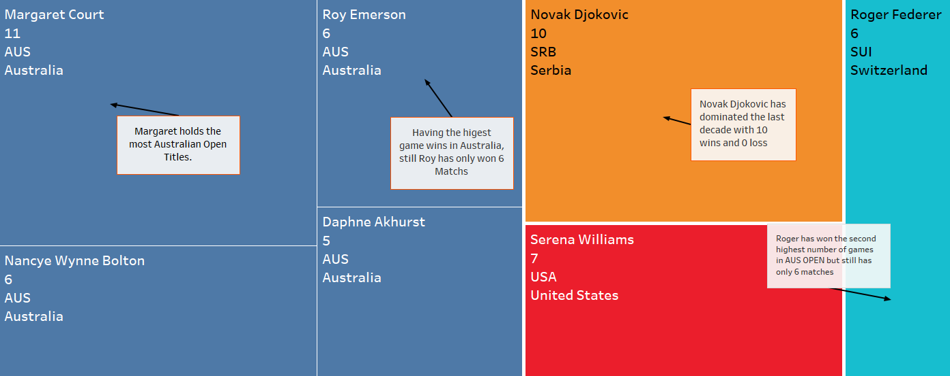
THE MOST DOMINANT PLAYERS – TREEMAP ANALYSIS
Key Insights:
Margaret Court (11 Titles) is the most successful player in Australian Open history.
Novak Djokovic (10 Titles) leads the modern era.
Serena Williams & Roger Federer (7 & 6 Titles) also dominate.
Australian players have historically been the most dominant in the tournament.

Slide 5

Key Insights:
Novak Djokovic (222 games won) is the highest-performing champion.
Margaret Court and Roy Emerson follow with 130+ games won.
This metric helps identify not just titleholders, but those who sustained dominance in every match.
CHAMPIONS BY TOTAL GAMES WON – DEEPER PERFORMANCE ANALYSIS

Slide 6

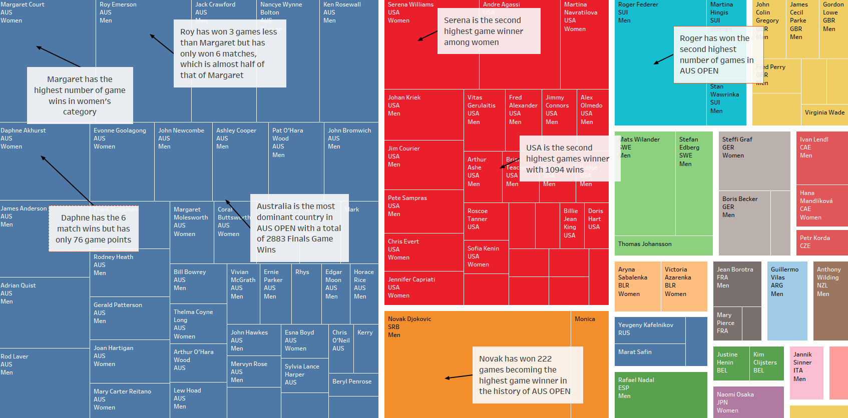

Slide 7


NATIONALITY-BASED PERFORMANCE – GEO MAP ANALYSIS
KEY INSIGHTS:
AUSTRALIA (94 TITLES) DOMINATES, FOLLOWED BY THE USA (43 TITLES), SERBIA (13), AND SWITZERLAND (10).
FRANCE HAS THE HIGHEST WIN RATE (71%), DESPITE FEWER TOTAL WINS.
EMERGING COUNTRIES (CHINA, BELARUS) SHOW PROMISING TRENDS IN RECENT YEARS.

Slide 8
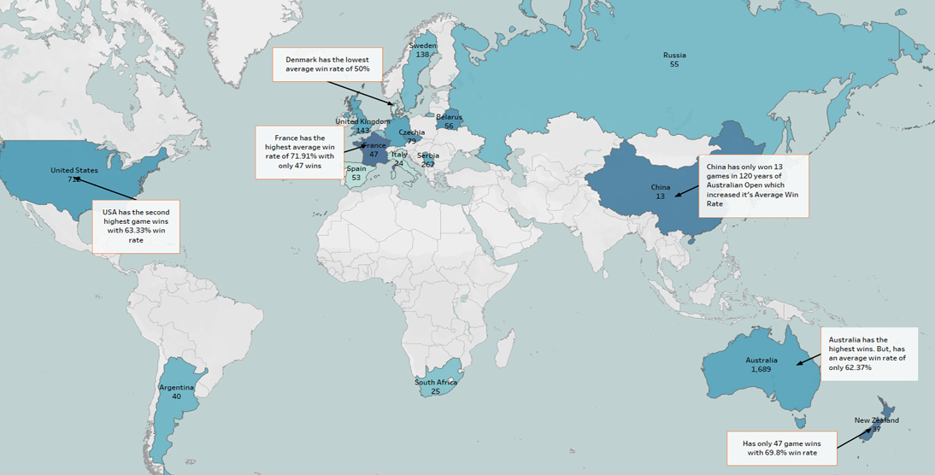

Slide 9
NATIONALITY-BASED PERFORMANCE – GEO MAP ANALYSIS
USA LEADS WITH THE HIGHEST TOTAL WINS IN AUSTRALIAN OPEN HISTORY.
Australia ranks 2nd, showing strong historical dominance.
Serbia’s win count boosted by Djokovic’s legacy.
Russia and Switzerland shine with strong win records from few players.

Slide 10
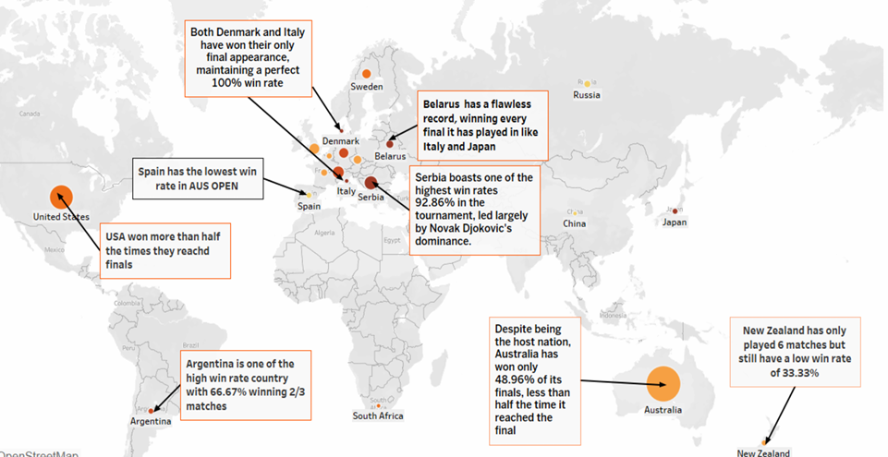

Slide 11
WIN RATE VS. RUNNER-UP PERFORMANCE – SCATTER PLOT ANALYSIS
Key Insights:
Novak Djokovic & Margaret Court had the highest win rates in finals.
Certain runner-ups (e.g., Andy Murray) faced the same champion multiple times, showing a strong rivalry.
Some champions, despite having more titles, had lower win rates (e.g., Roy Emerson).

Slide 12
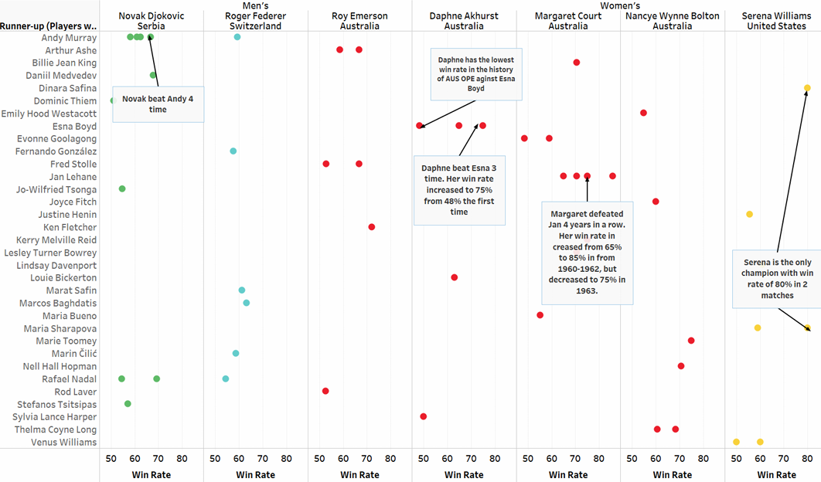

Slide 13
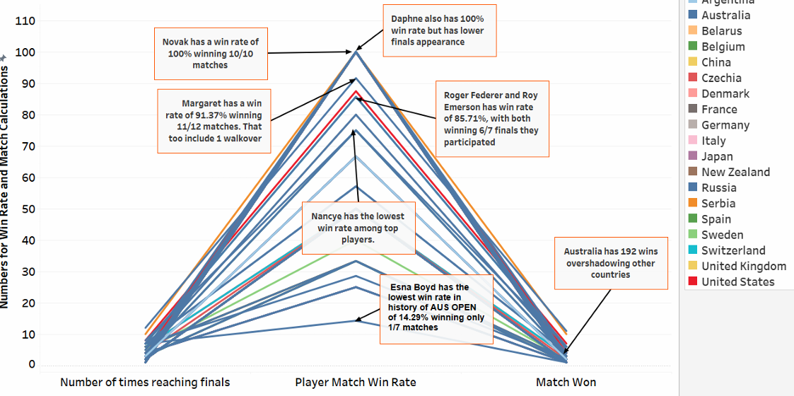
PARALLEL COORDINATE CHART – LONG-TERM CONSISTENCY
Key Insights:
Margaret Court & Novak Djokovic were the most consistent players across all metrics.
Some players had high total wins but lower win rates (e.g., Esna Boyd, 14.29%).
This highlights which players maintained high performance over multiple years.

Slide 14


BEST PLAYER IN AUSTRALIAN OPEN HISTORY – THE FINAL VERDICT
Data-Driven Conclusion:
Margaret Court (11 Titles) is statistically the greatest player, leading in total wins & match dominance.
Novak Djokovic (10 Titles) remains undefeated in finals, making him the greatest modern-era player.
The choice between them depends on era-based dominance vs. consistency across decades.

Slide 15
THANKS

